Slide 1
High-Throughput CNN on an FPGA by Customized JPEG Compression

Slide 2
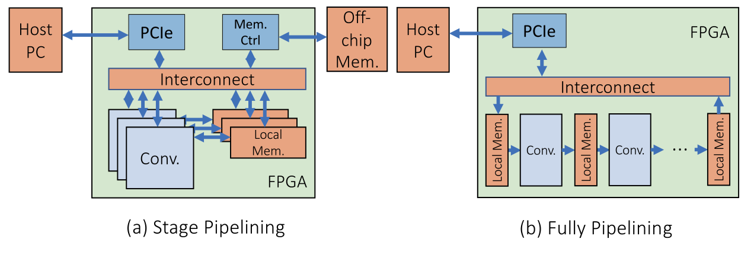
Contents
High throughput system by customized JPEG compression
CNN model towards on-chip memory realization
Fully pipelined CNN architecture
Results and comparison

Slide 3
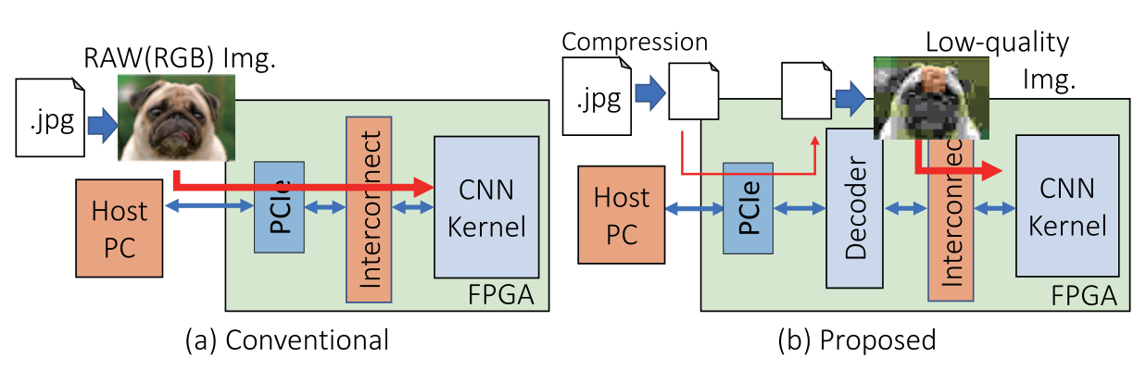
Bottle neck
AWS F1 provides overall read/write at 6.5GB/s from host CPU to FPGA.

Slide 4
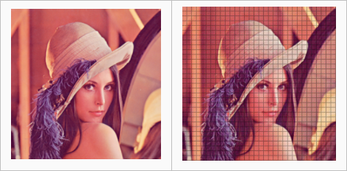
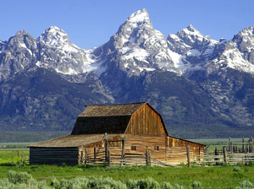
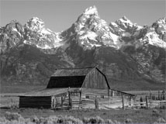


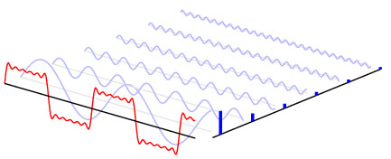
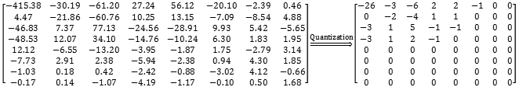
JPEG
Segmentation
Color mapping(RGB2YCrCb)
Discrete cosine transform
Quantization
Huffman coding
Head, Marker

Slide 5
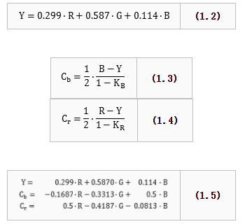

Slide 6

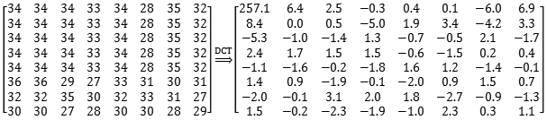

Slide 7
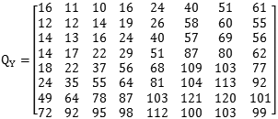
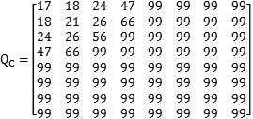

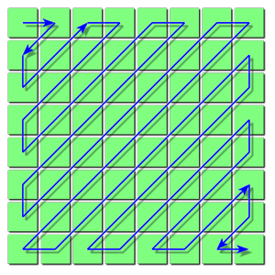

Slide 8
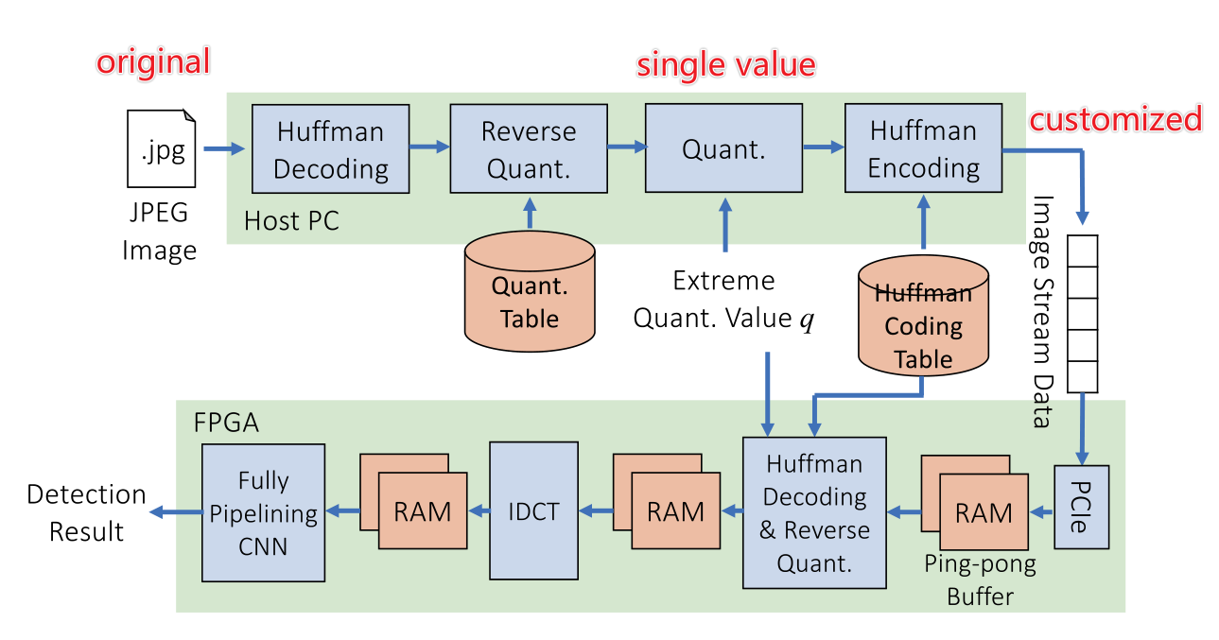
Customized JPEG
ping
pong

Slide 9
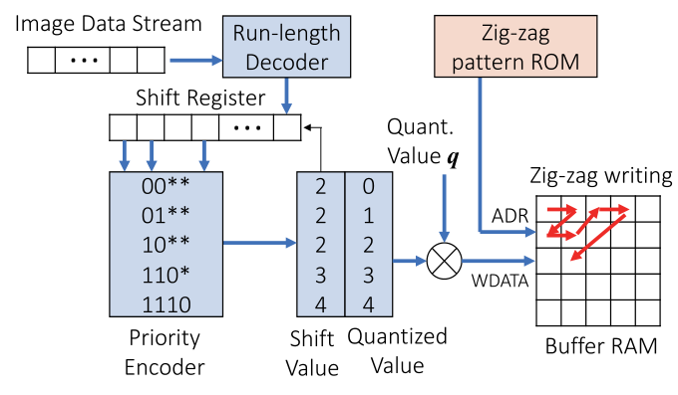
Customized JPEG

Slide 10
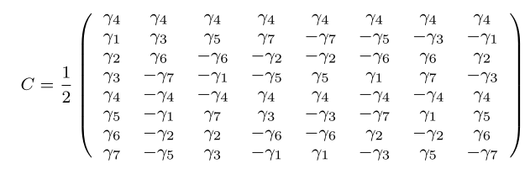
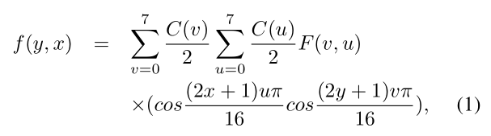
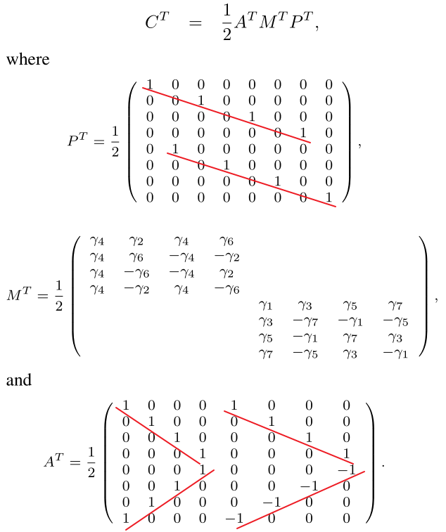
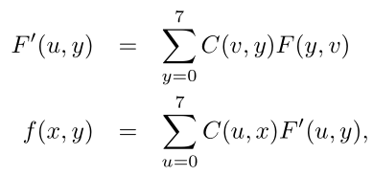

Customized JPEG

Slide 11
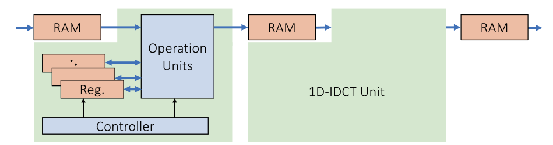
Customized JPEG

Slide 12
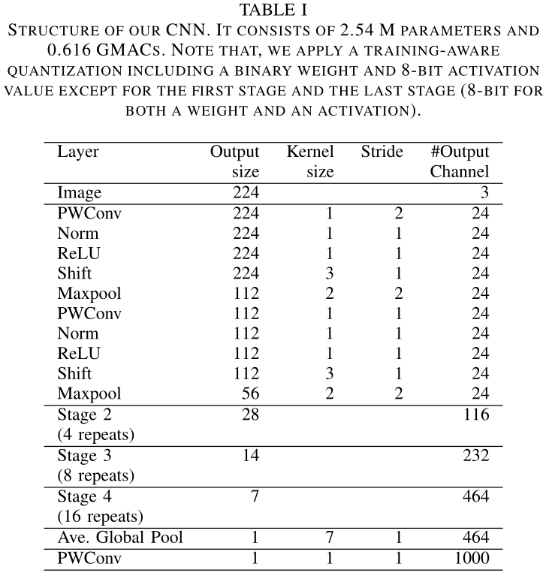
CNN model towards on-chip memory realization

Slide 14
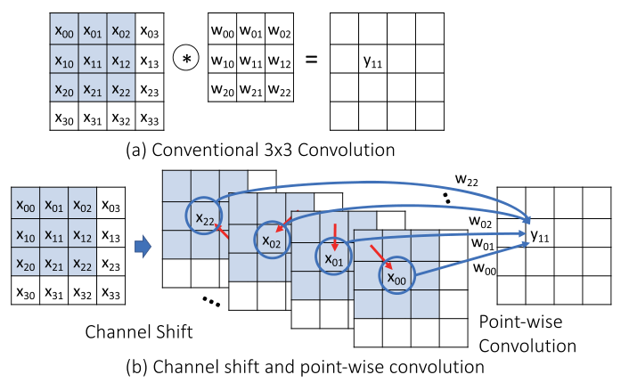
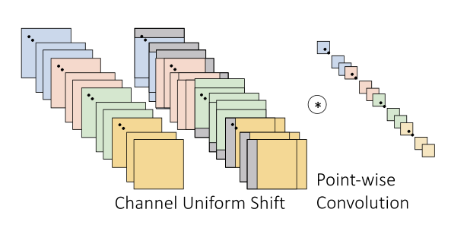
CNN model towards on-chip memory realization

Slide 15
CNN model towards on-chip memory realization
A training-aware quantization
A binary weight and 8-bit activation value except for the first state and the last stage (8-bit for both a weight and an activation)
Quantization Strategy
Apply scaling factors for each layer with constant unlearned values equal to the layer-specific standard deviations used for initialization
Use an 8-bit precision layer for the first and the last layers to keep information loss to a minimum
Follow the guidelines for low-precision network training

Slide 16
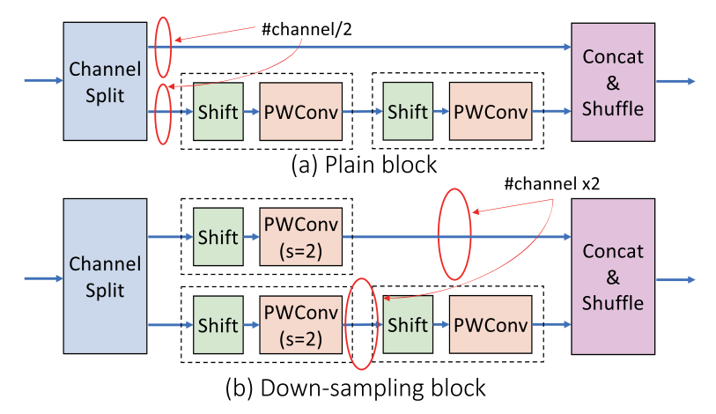
CNN model towards on-chip memory realization

Slide 17
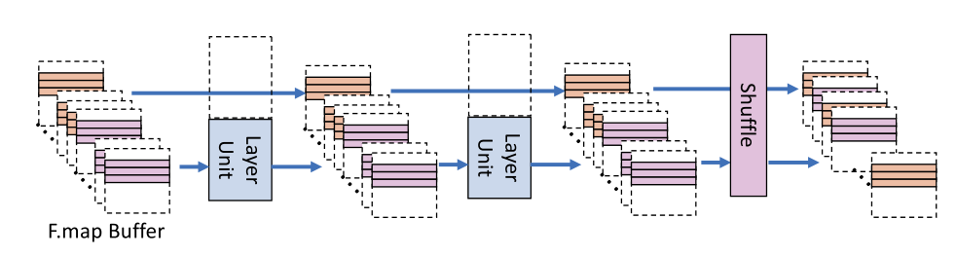
Fully pipelined CNN architecture

Slide 18
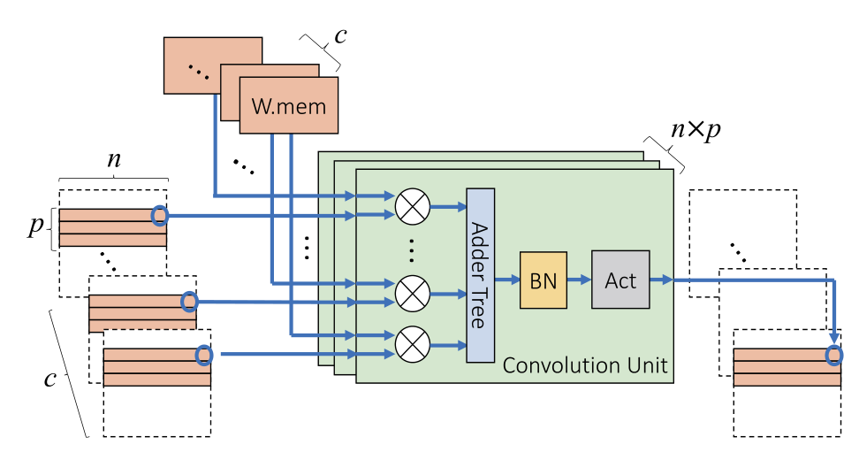
Fully pipelined CNN architecture

Slide 19
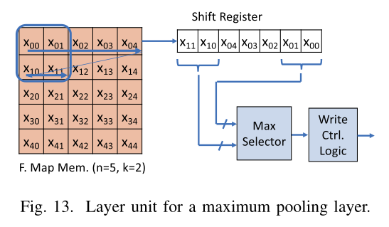
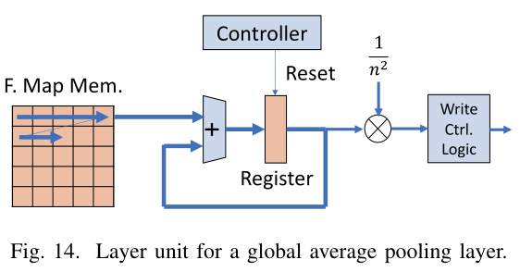
Fully pipelined CNN architecture
adjust parallel parameters c and p
multi-port memories with high bandwidth memory access
pooling

Slide 20
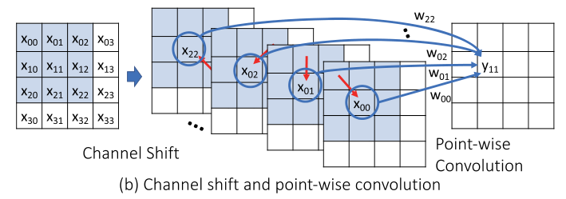
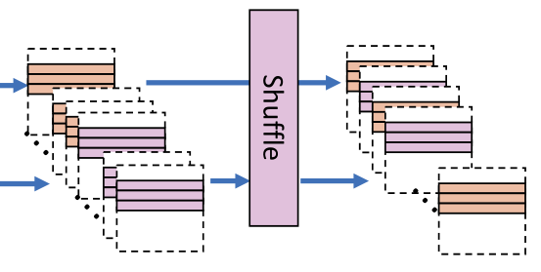
Fully pipelined CNN architecture
Shift and shuffle
000
001
010
011
100
101
110
111
000
100
001
101
010
110
011
111
0 1 2 → 1 2 3
0 1 2 → 4 5 6

Slide 21
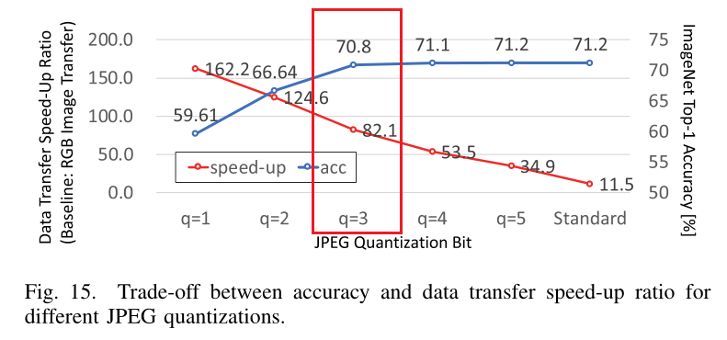
Result

Slide 22
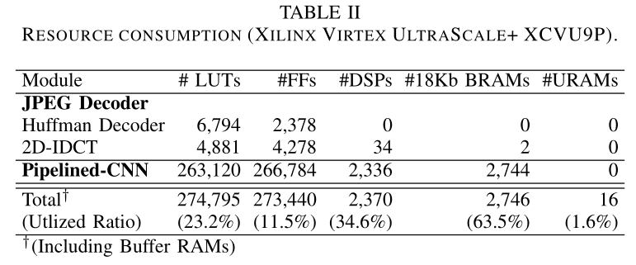
Result

Slide 23
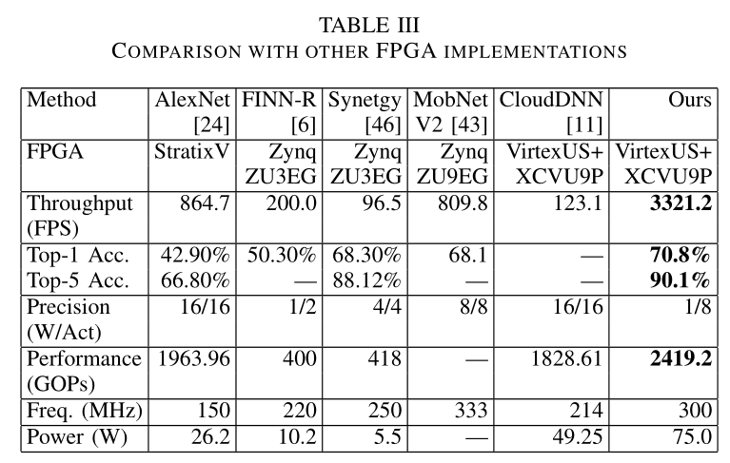
Result

Slide 24
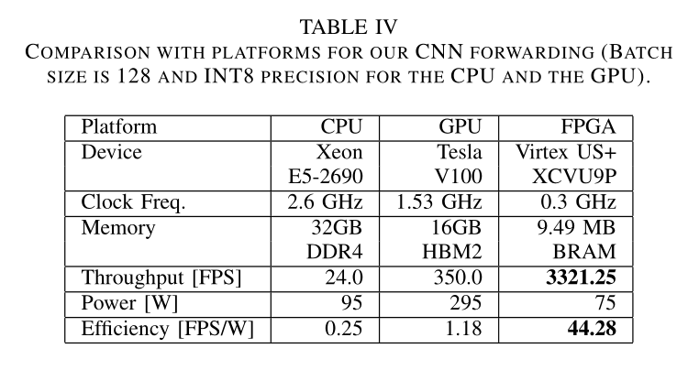
Result

